Slide 1
Introduction to UNIX

Slide 2

Introduction to UNIX
Unix is a family of multitasking, multiuser computer operating systems that derive from the original AT&T Unix, developed in the 1970s at the Bell Labs research center by Ken Thompson, Dennis Ritchie, and others.
Unix is a proprietary operating system commonly used in internet servers, workstations and PCs by Sun Microsystems, Intel, HP etc.
The Unix OS is mainly used on large server systems, mainframes, expensive and high-end computer systems at big MNCs and institutions. Unix is being developed, maintained and updated by AT&T developers.
Different versions of Unix are as follows:
AIS (IBM)
BSD (University of California)
HP – UX (HP)
Solaris (Sun Microsystems)

Slide 3
Introduction to UNIX
The Unix OS works primarily on Command Line Interface, though, recently, there have been developments for GUI on Unix systems.
Unix is not free. Different flavors of Unix have different cost structures according to vendors.
Unix is not as flexible as Linux. It has less compatibility with different types of hardware.
Unix installation requires a strict and well-defined hardware machinery and works only on specific CPU machines. It is mostly used in big data servers around the world.

Slide 4
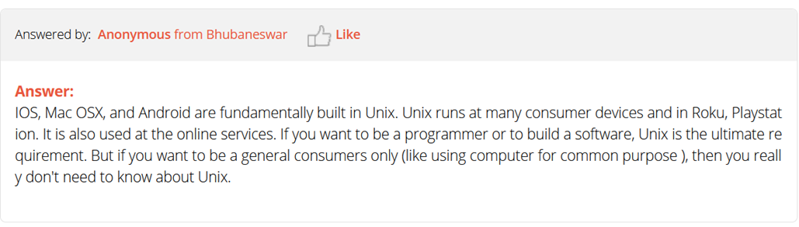
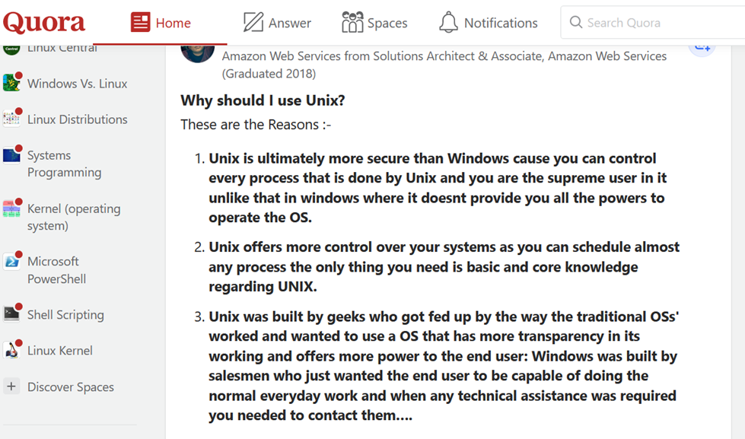
Why do we want to learn UNIX?

Slide 5
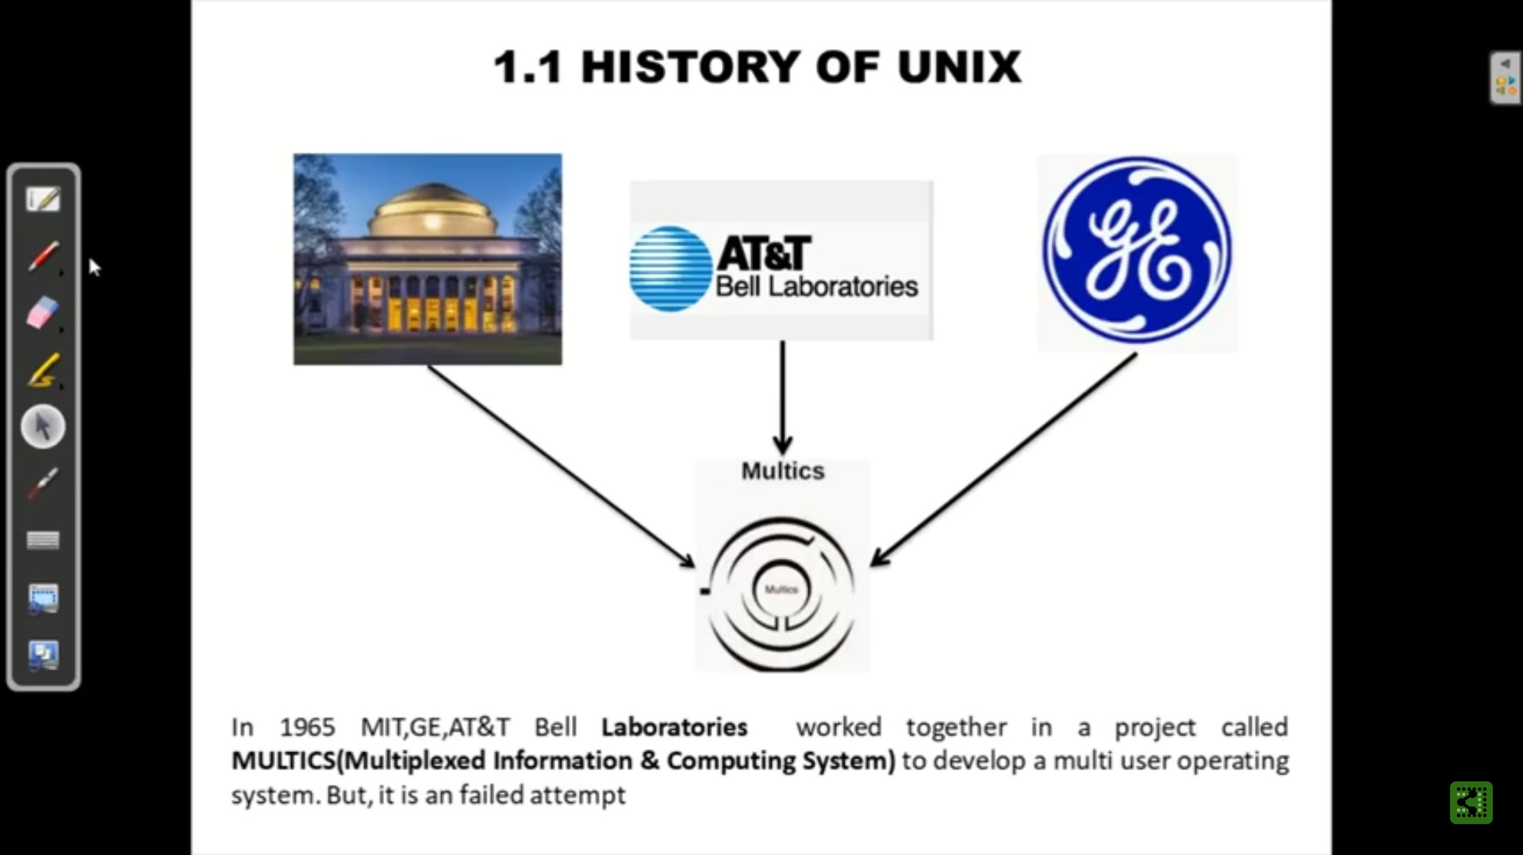

Slide 6
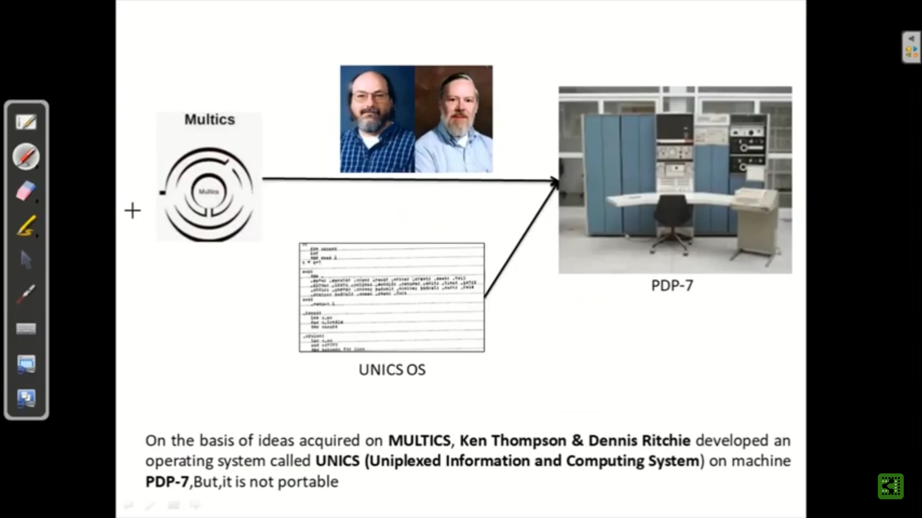

Slide 7
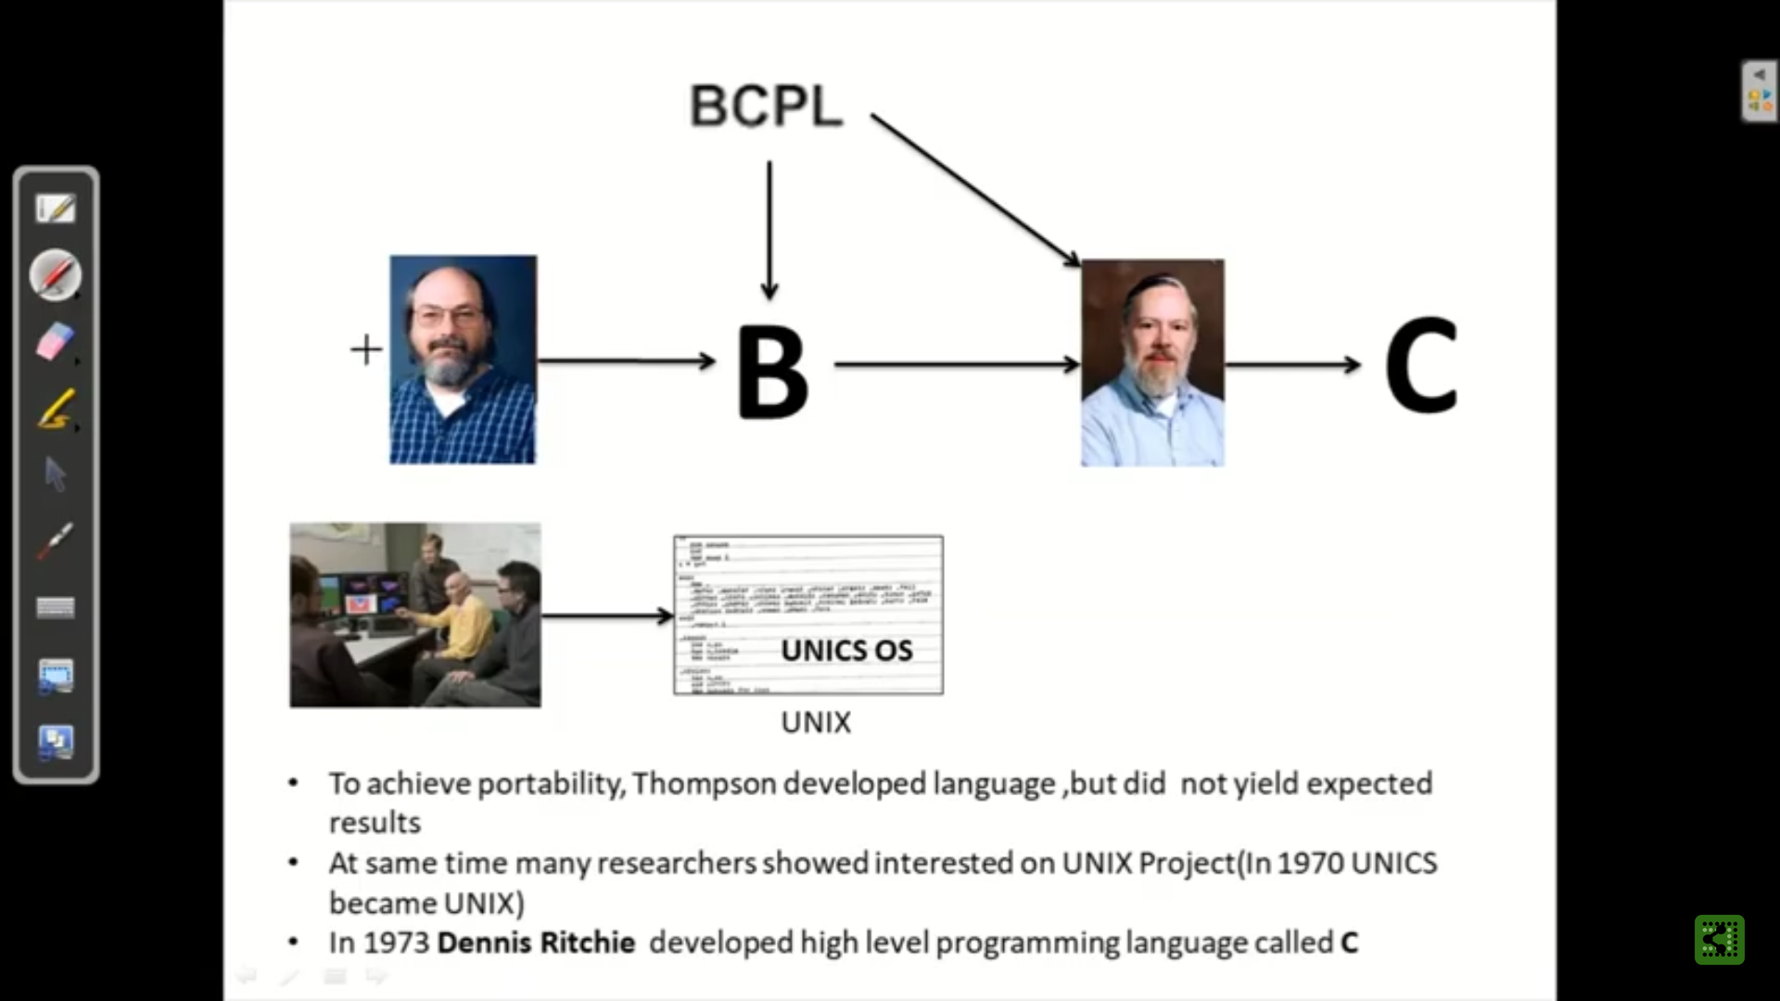
B

Slide 8
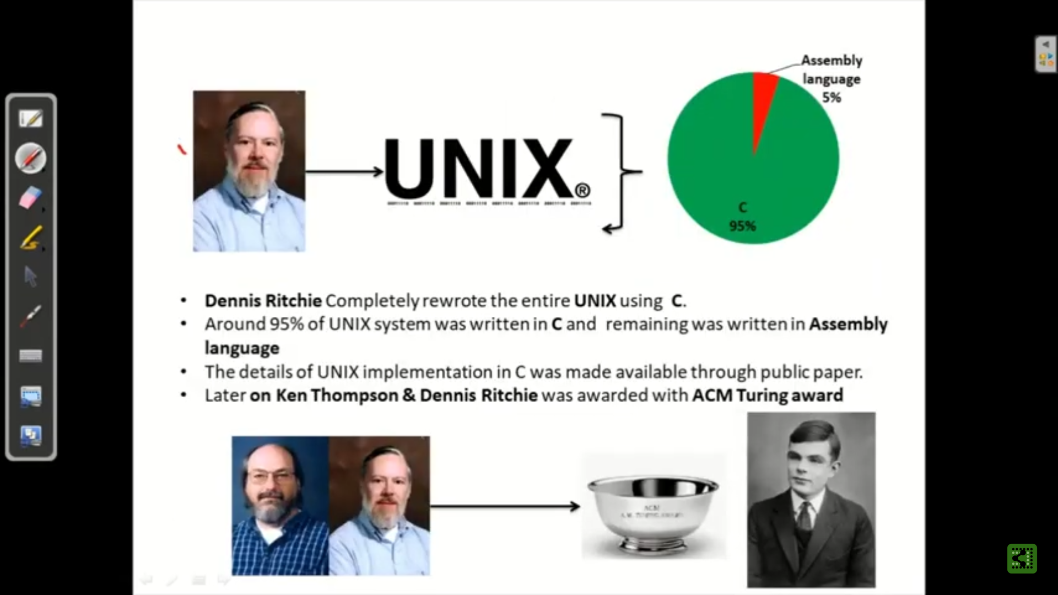

Slide 9
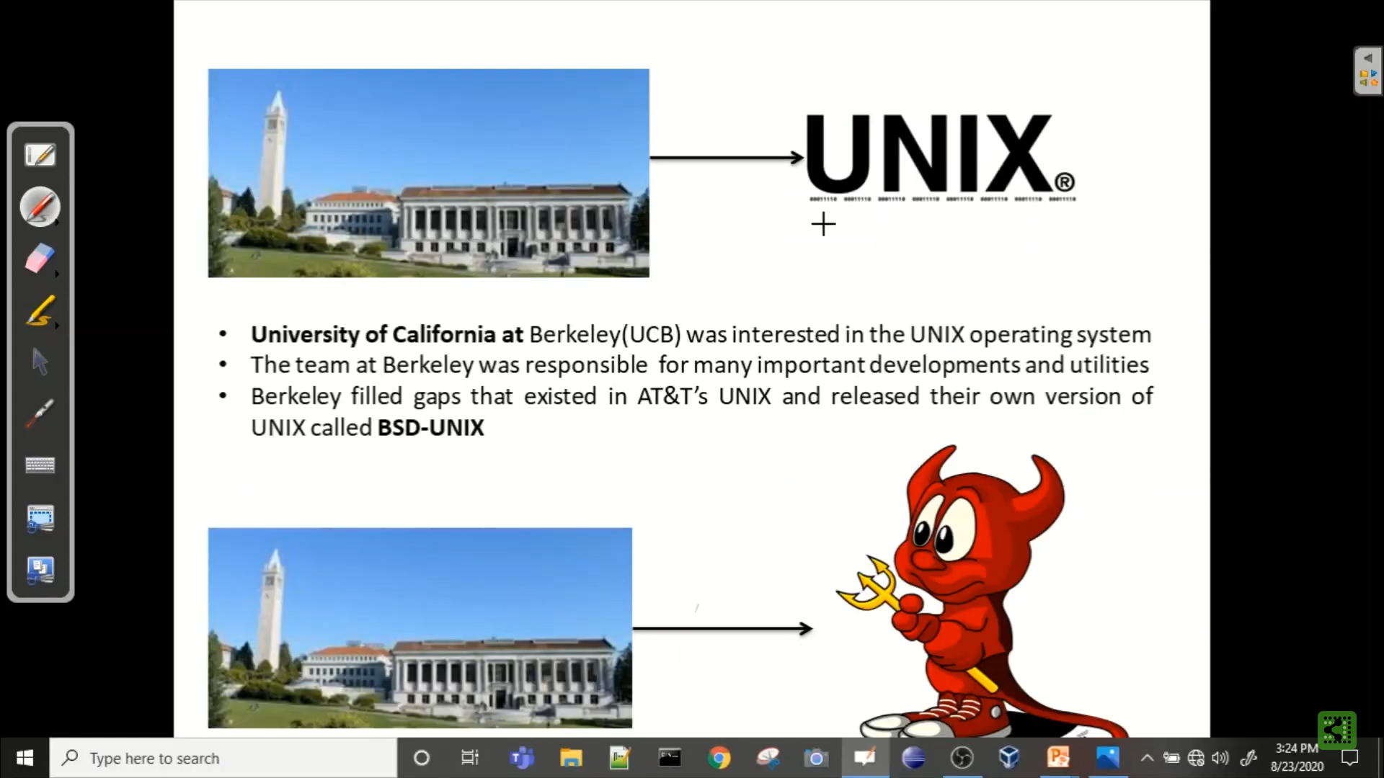

Slide 10
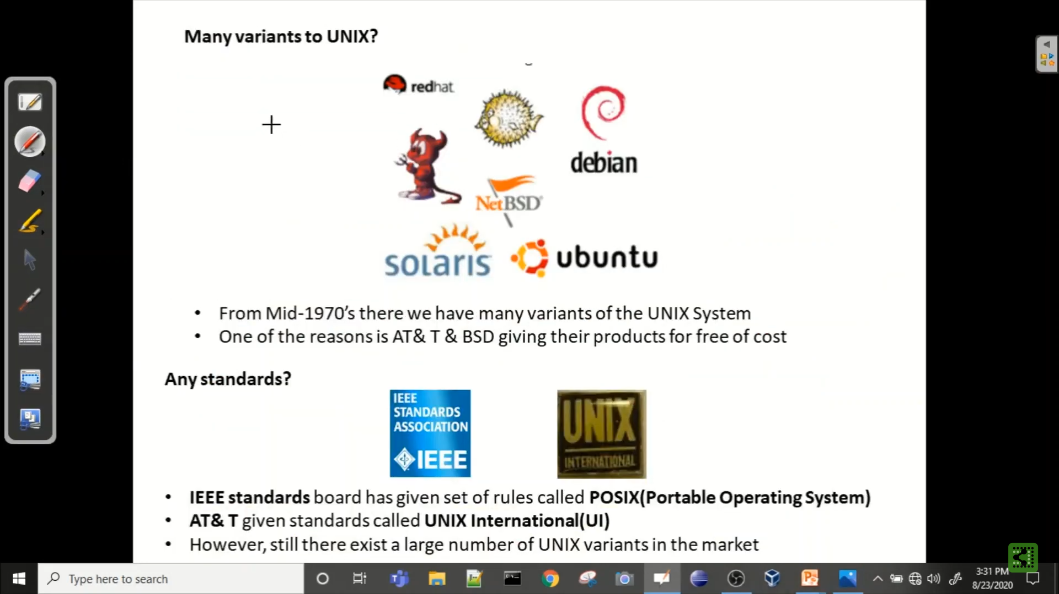
With the growing popularity of microprocessors, other companies ported the UNIX system to new machines, but its simplicity and clarity tempted many developers to enhance it in their own way, resulting in several variants of the basic system.
Unix was available to universities for educational purposes and licenses were given to commercial institutions as well.

Slide 11
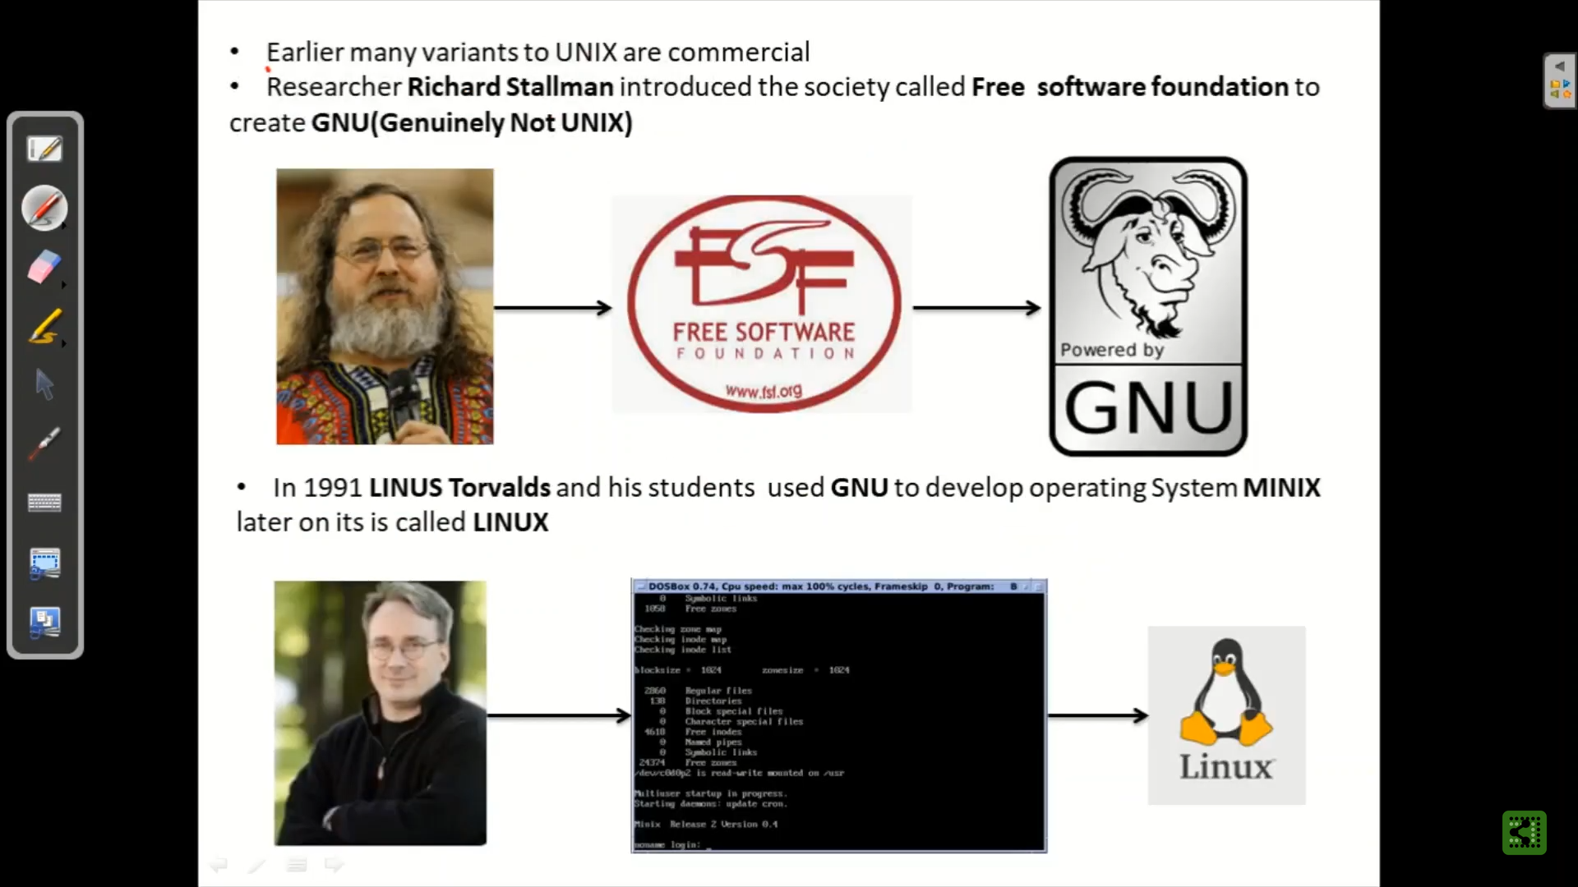
- GNU is a Unix-like operating system.

Slide 12
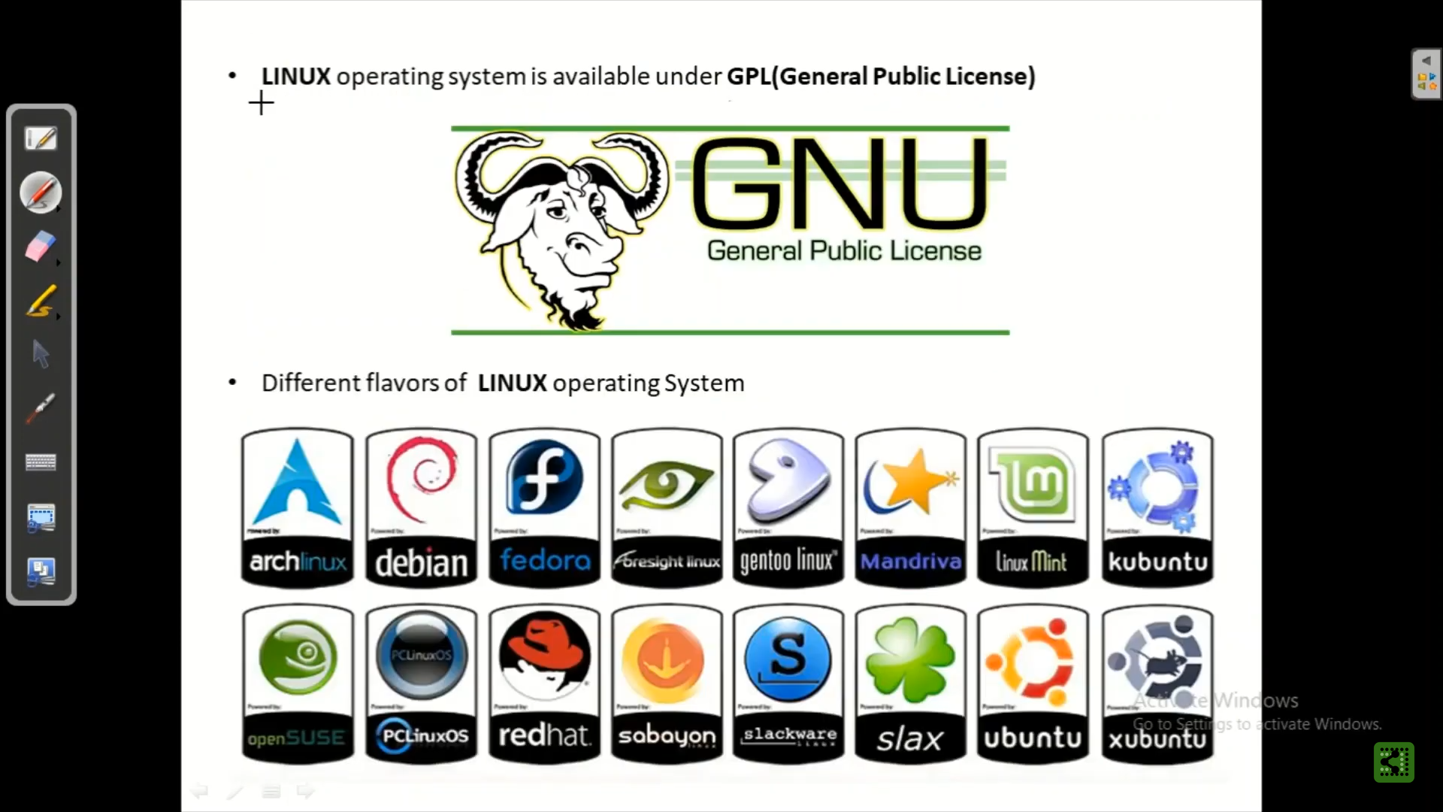

Slide 13
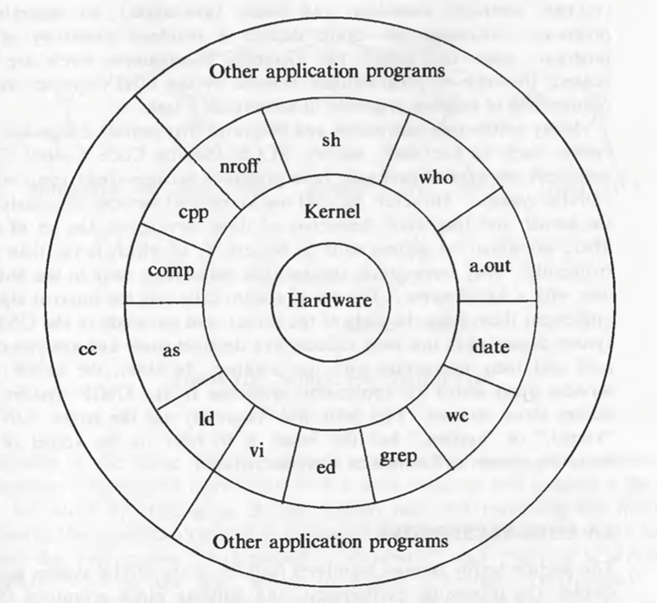
UNIX System Structure

Slide 14
UNIX System Structure
The hardware at the center of the diagram provides the operating system with basic services.
The operating system interacts directly with the hardware, providing common services to programs and isolating them from hardware characteristics and it is called kernel, isolating it from user programs.
Programs are independent of the underlying hardware, it is easy to move them between UNIX systems running on different hardware, if the programs do not make assumptions about the underlying hardware.
Programs such as the shell and editors (ed and vi) shown in the outer layers interact with the kernel by invoking a well defined set of system calls .
The system calls instruct the kernel to do various operations for the calling program and exchange data between the kernel and the program.

Slide 15
UNIX System Structure
Commands and private user programs may also exist in this layer as indicated by the program whose name is a. out, the standard name for executable files produced by the C compiler.
Other application programs can be build on top of lower-level programs, hence the existence of the outermost layer.
For example, the standard C compiler, cc, is in the outermost layer of the figure: it invokes a C preprocessor, two-pass compiler, assembler, and loader link-editor, all separate lower-level programs.
Many application subsystems and programs provide a high-level view of the system such as the shell, editors, SCCS (Source Code Control System), and document preparation packages.

Slide 16
Why UNIX became so popular?
The system is written in a high-level language, making it easy to read, understand, change, and move to other machines.
It has a simple user interface that has the power to provide the services that users want.
It provides primitives that permit complex programs to be built from simpler programs.
It uses a hierarchical file system that allows easy maintenance and efficient implementation.
It uses a consistent format for files, the byte stream, making application programs easier to write.
It provides a simple, consistent interface to peripheral devices.
It is a multi-user, multi-process system; each user can execute several processes simultaneously.
It hides the machine architecture from the user, making it easier to write programs that run on different hardware implementations.

Slide 17
Building block primitives
UNIX system is to provide operating system primitives that enable users to write small, modular programs that can be used as building blocks to build more complex programs.
One such primitive visible to shell users is the capability to redirect I/O.
Processes conventionally have access to three files: they read from their standard input file, write to their standard output file, and write error messages to their standard error file.
Processes executing at a terminal typically use the terminal for these three files, but each may be "redirected" independently.
For instance, the command line
Is
lists all files in the current directory on the standard output.

Slide 18
Building block primitives
But the command line
Is > output
redirects the standard output to the file called "output" in the current directory, using the creat system call mentioned above.
Similarly, the command line
mail mjb < letter
opens the file "letter" for its standard input and mails its contents to the user named "mjb."
Processes can redirect input and output simultaneously, as in
wc –l < a.txt > count.txt 2> error.txt

Slide 19
Building block primitives
The second building block primitive is the pipe, a mechanism that allows a stream of data to be passed between reader and writer processes.
Processes can redirect their standard output to a pipe to be read by other processes that have redirected their standard input to come from the pipe.
For example, the program grep searches a set of files (parameters to grep) for a given pattern:
grep main a.c b.c c.c
searches the three files a.c, b.c, and c.c for lines containing the string "main”

Slide 20
Building block primitives
The program wc with the option -l counts the number of lines in the standard input file. The command line
grep main a.c b.c c.c | wc -l
counts the number of lines in the files that contain the string "main"; the output from grep is "piped" directly into the wc command
The use of pipes frequently makes it unnecessary to create temporary files.

Slide 21
Operating system services
Controlling the execution of processes by allowing their creation, termination or suspension, and communication.
Scheduling processes fairly for execution of the CPU. Processes share the CPU in a time-shared manner: the CPU executes a process, the kernel suspends it when its time quantum elapses, and the kernel schedules another process to execute. The kernel later reschedules the suspended process.
Allocating main memory for an executing process. The kernel allows processes to share portions of their address space under certain conditions, but protects the private address space of a process from outside tampering. If the system runs low on free memory, the kernel frees memory by writing a process temporarily to secondary memory, called a swap device. If the kernel writes entire processes to a swap device, the implementation of the UNIX system is called a swapping system; if it writes pages of memory to a swap device, it is called a paging system.

Slide 22
Operating system services
Allocating secondary memory for efficient storage and retrieval of user data. This service constitutes the file system. The kernel allocates secondary storage for user files, reclaims unused storage, structures the file system in a well understood manner, and protects user files from illegal access.
Allowing processes controlled access to peripheral devices such as terminals, tape drives, disk drives, and network devices.

Slide 23
ASSUMPTIONS ABOUT HARDWARE
The execution of user processes on UNIX systems is divided into two levels: user and kernel.
When a process executes a system call, the execution mode of the process changes from user mode to kernel mode : the operating system executes and attempts to service the user request, returning an error code if it fails.
Even if the user makes no explicit requests for operating system services, the operating system still does bookkeeping operations that relate for the user process, handling interrupts, scheduling processes, managing memory, and so on.
Many machine architectures (and their operating systems) support more levels than these two, but the two modes, user and kernel, are sufficient for UNIX systems.

Slide 24
ASSUMPTIONS ABOUT HARDWARE
The differences between the two modes are
Processes in user mode can access their own instructions and data but not kernel instructions and data (or those of other processes) .
Processes in kernel mode, however, can access kernel and user addresses.
For example, the virtual address space of a process may be divided between addresses that are accessible only in kernel mode and addresses that are accessible in either mode.
Some machine instructions are privileged and result in an error when executed in user mode.
For example, a machine may contain an instruction that manipulates the processor status register
Although the system executes in one of two modes, the kernel runs on behalf of a user process.
The kernel is not a separate set of processes that run in parallel to user processes, but it is part of each user process.

Slide 25
Interrupts and exceptions
The UNIX system allows devices such as I/O peripherals or the system clock to interrupt the CPU asynchronously.
On receipt of an interrupt, the kernel saves its current context (a frozen image of what the processor was doing), determines the cause of the interrupt, and services the interrupt.
After servicing the interrupt, it restores its interrupted context and begins execution as if nothing had happened.
The hardware usually prioritizes devices according to the order that interrupts should be handled: When the kernel services an interrupt, it blocks out lower priority interrupts but services higher priority interrupts.

Slide 26
Interrupts and exceptions
An exception condition refers to unexpected events caused by a process, such as addressing illegal memory, executing privileged instructions, dividing by zero, and so on.
They are distinct from interrupts, which are caused by events that are external to a process.
Exceptions happen "in the middle" of the execution of an instruction, and the system attempts to restart the instruction after handling the exception; interrupts are considered to happen between the execution of two instruction, and the system continues with the next instruction after servicing the interrupt.

Slide 27
Processor Execution Levels
The kernel to prevent occurrence of interrupts when it is doing some important work.
For instance, the kernel may not want to receive a disk interrupt while manipulating linked lists, because handling the interrupt could corrupt the pointers
In such situations, if the interrupts are not prevented, the kernel itself might get corrupt. Computers typically have a set of privileged instructions that set the processor execution level in the processor status word.
Setting the processor execution level to certain values masks off interrupts from the level and lower levels, allowing only higher-level interrupts.

Slide 28
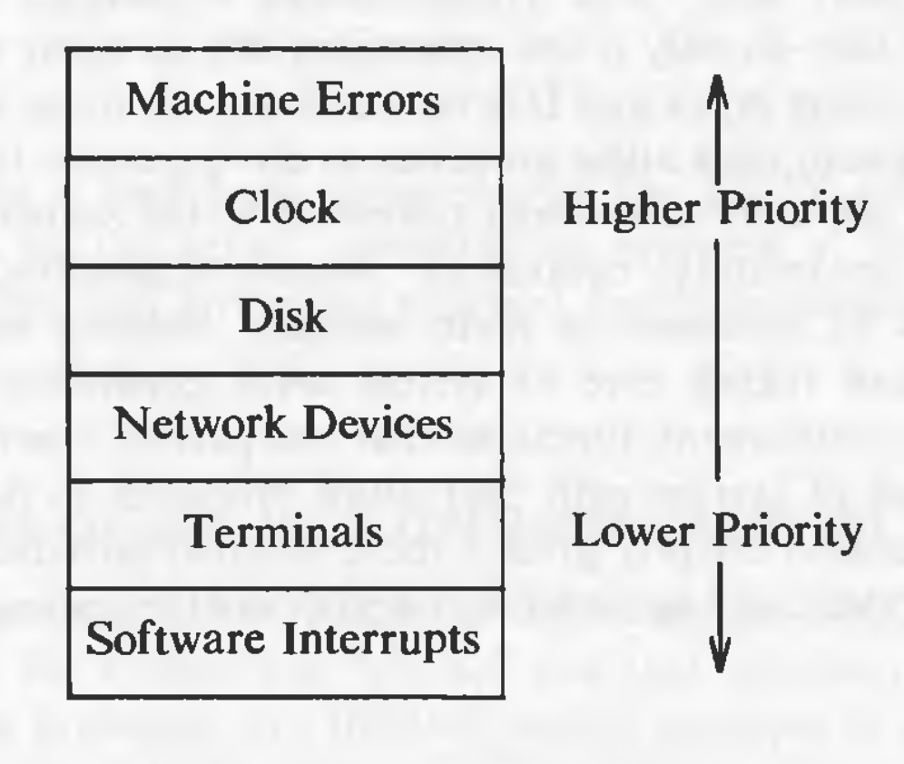
Processor Execution Levels
The below figure shows a sample set of execution levels.
If the kernel masks out disk interrupts, all interrupts except for clock interrupts and machine error interrupts are prevented. If it masks out software interrupts, all other interrupts may occur.

Slide 29
Memory management
The kernel permanently resides in the main memory.
When compiling a program, the compiler generates a set of addresses in the program that represent addresses of variables and data structures of the addresses of instructions such as functions.
The compiler generates the virtual addresses as if no other program will execute simultaneously on the physical machine.
When the program is run on the machine, the kernel allocates space in main memory for it, but the virtual addresses generated by the compiler need not be identical to the physical addresses that they occupy in the machine.
The kernel coordinates with the machine hardware to set up a virtual to physical address translation that maps the compiler-generated addresses to the physical machine addresses.

Slide 30
Thank you

